Slide 1
12monkeys
Synthetic Health Data Hackathon 2020

Slide 2


Team
Kevin Albert
Andre Fontes

Slide 3
Track
Diabetes - Bioinformatics - Data Set
Diabetes - Machine Learning - Data Set

Slide 4
Tools

Slide 5
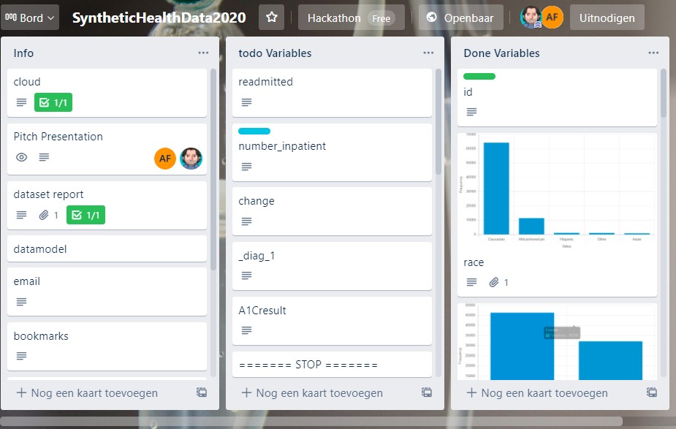
Status page
trello.com/b/hqd6UMGH

Slide 6
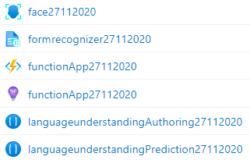
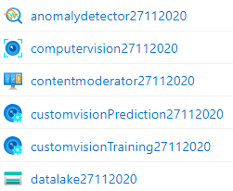
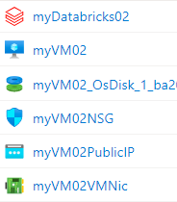
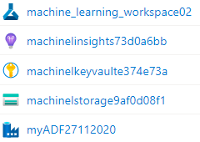
Cloud

Slide 7
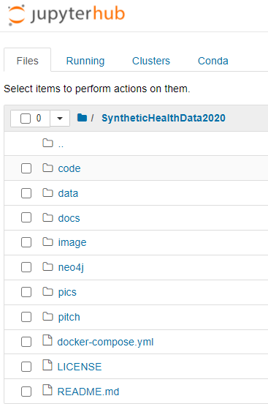
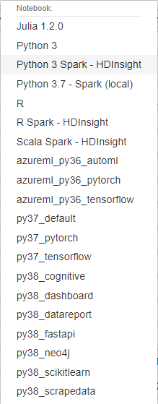
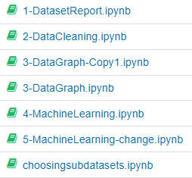
Development environment

Slide 8
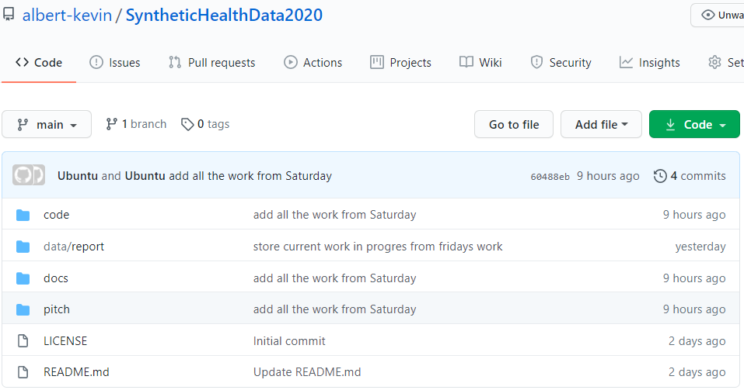
Git repo
https://github.com/albert-kevin/SyntheticHealthData2020

Slide 9
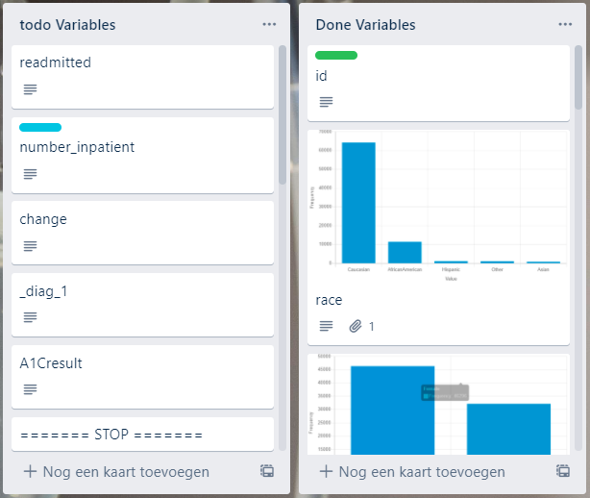
Datamodel

Slide 10
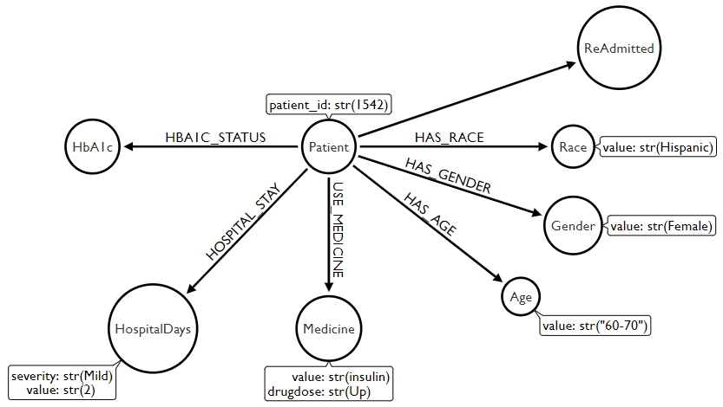
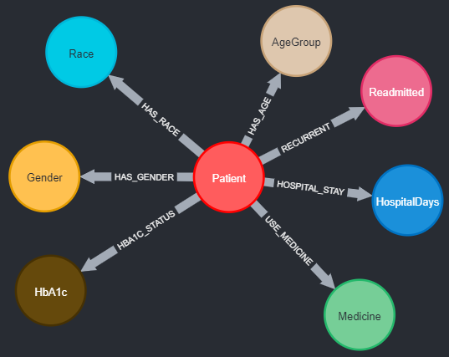
Datamodel

Slide 11
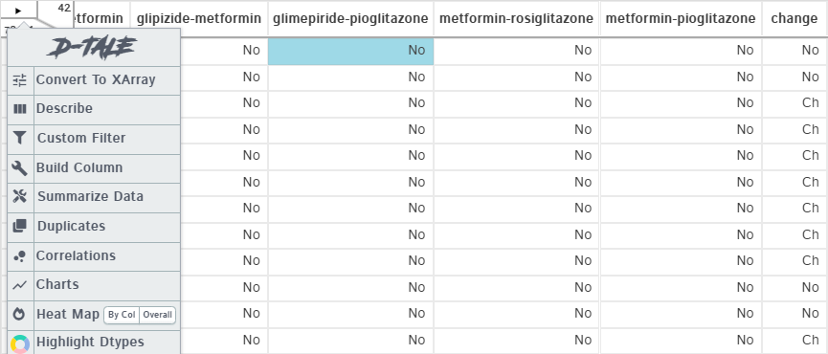
interactive dataset dashboard
http://13.93.37.217:40000/dtale/main/1

Slide 12
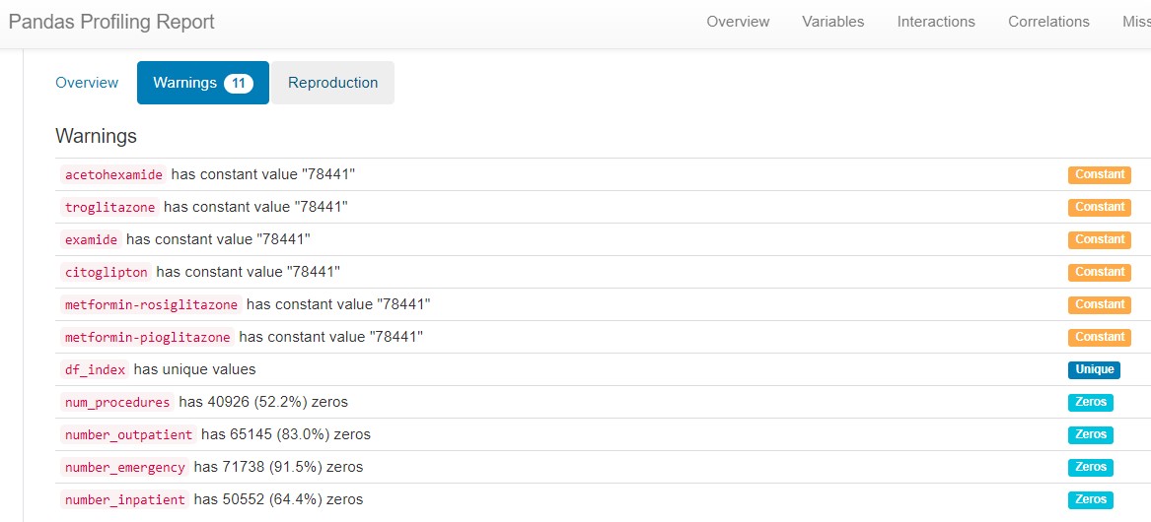
static dataset report

Slide 13
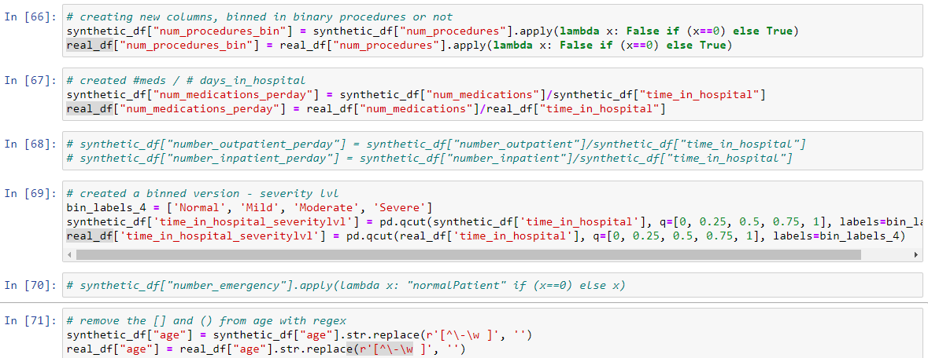
Data cleaning

Slide 14
Machine Learning
Multilabel Classification
target “readmitted”
primary metric “AUC_weighted”
cross validation 5 (full dataset)
no DeepLearning used
autoML
auto feature engineering
run on cloud VM (4 core, 32GB) can scale to cluster 20 nodes
cloud infrastructure (compute, storage, VM)
synthetic dataset Version 1

Slide 15
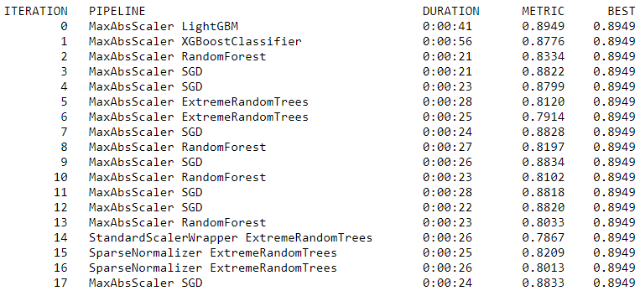
Machine Learning

Slide 16
Machine Learning
Synthetic data
AUC_weighted
0.8957
log_loss
0.5496
accuracy
0.7771
f1_score_weighted
0.7736
Real data
AUC_weighted
0.6533
log_loss
0.8977
accuracy
0.5755
f1_score_weighted
0.5217

Slide 17
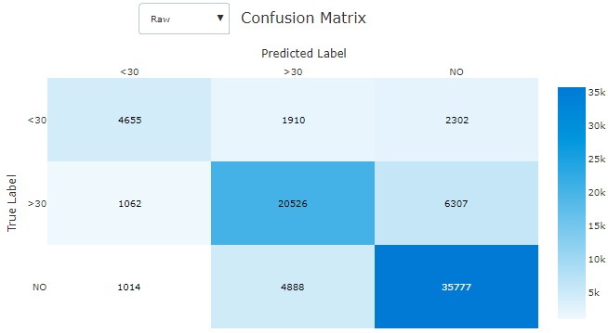
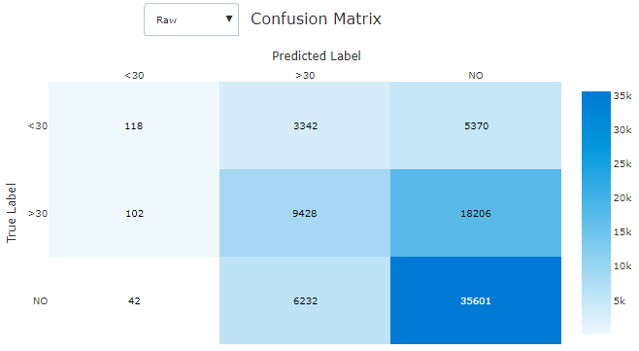
Machine Learning
Synthetic data
Real data

Slide 18
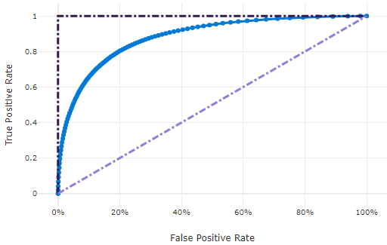
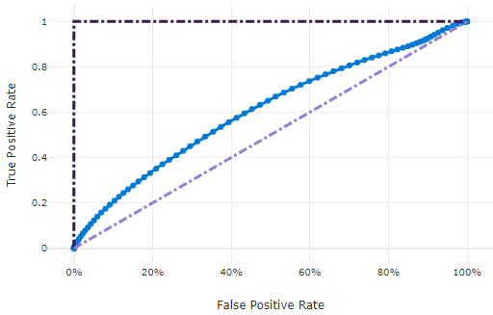
ROC
Synthetic data
Real data

Slide 19
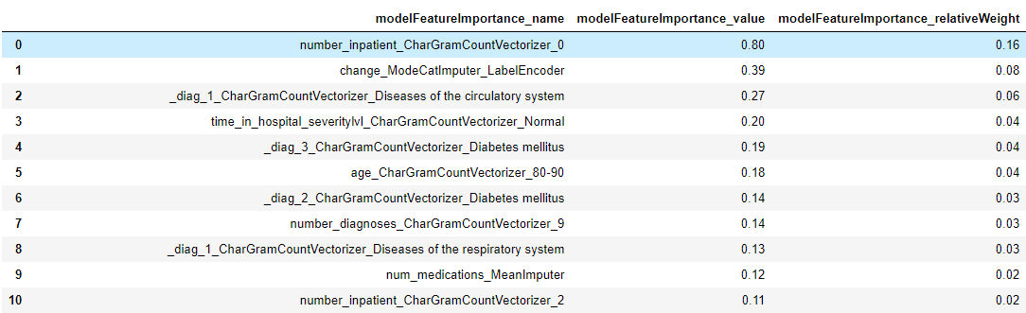
Feature Importance
Synthetic data

Slide 20
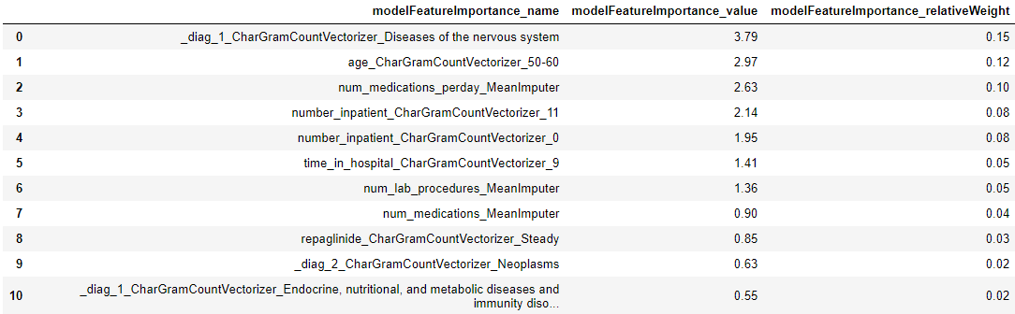
Feature Importance
Real data

Slide 21
Some Interesting Findings

Slide 22
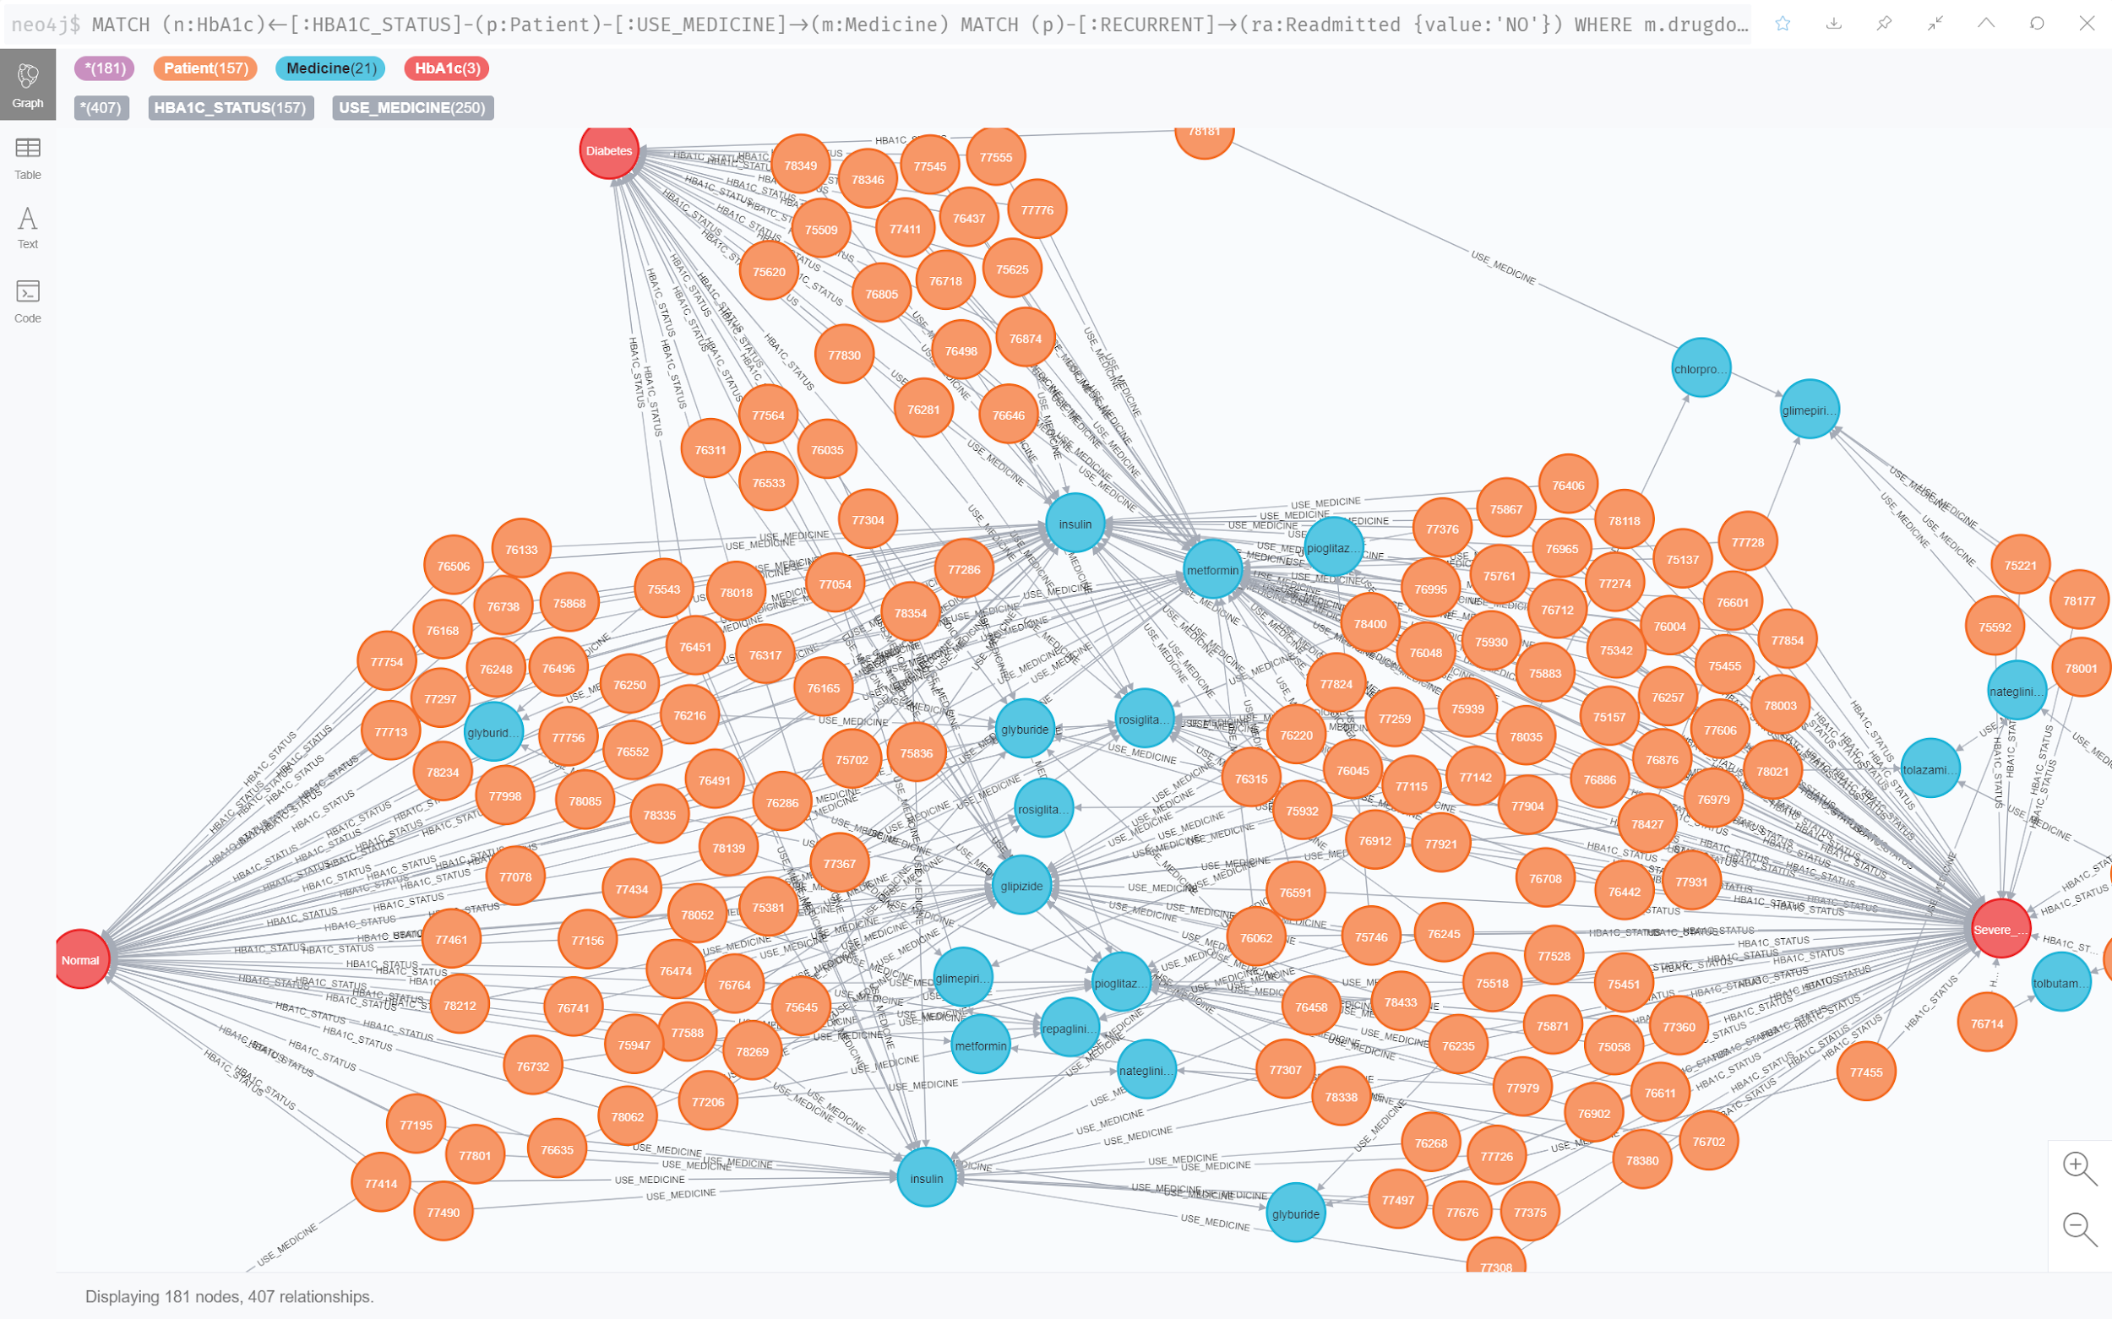
No readmission
HbA1c groups (red nodes):
Normal (<7%) Diabetes (7%<x<8%) Severe Diabetes (>8%)

Slide 23
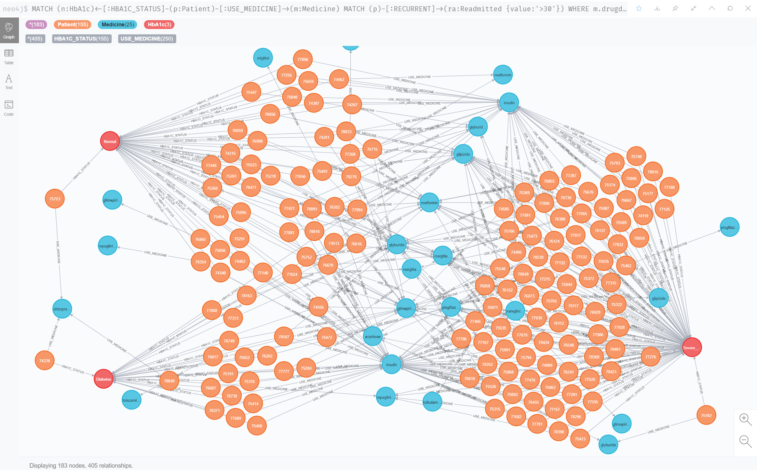
Readmitted after 30 days
HbA1c groups (red nodes):
Normal (<7%) Diabetes (7%<x<8%) Severe Diabetes (>8%)

Slide 24
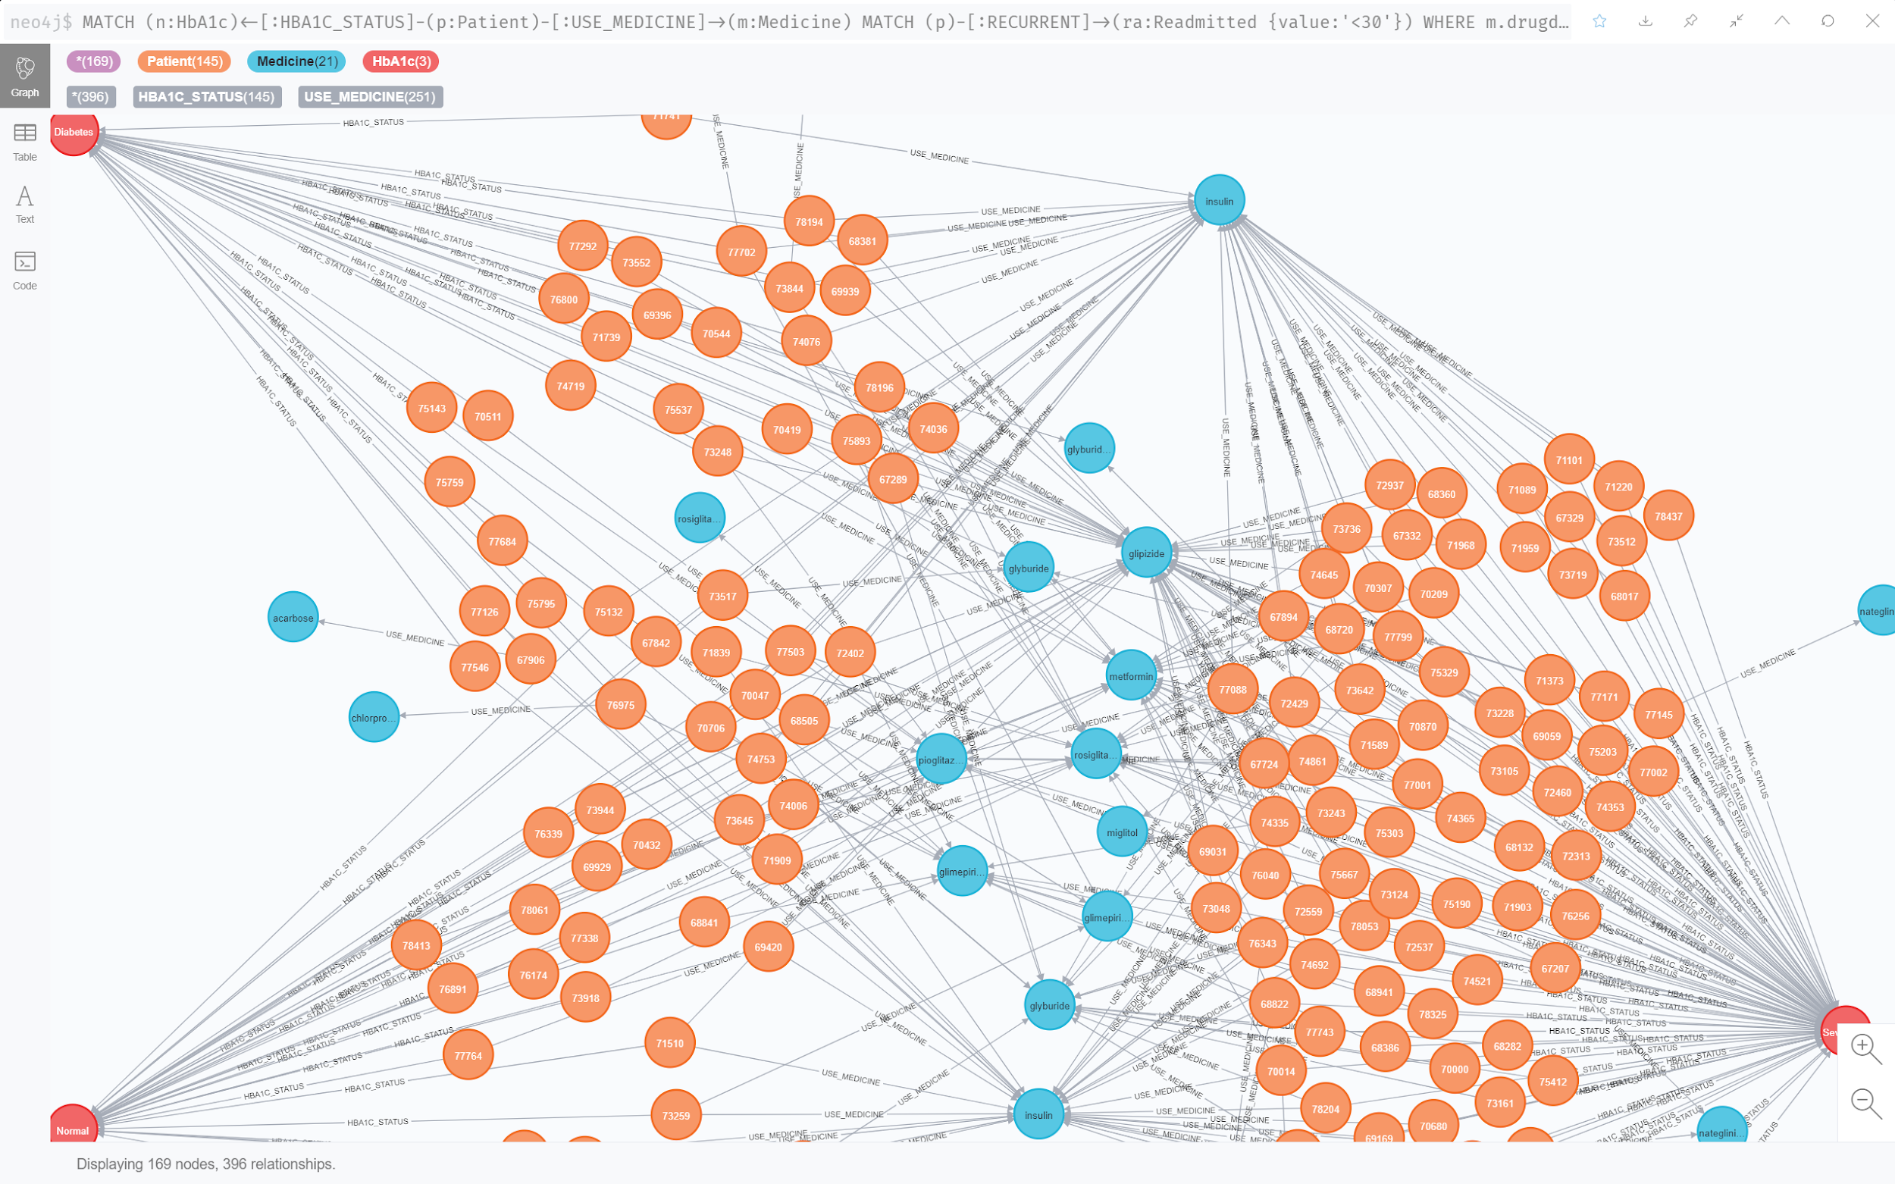
Readmitted within 30 days
HbA1c groups (red nodes):
Normal (<7%) Diabetes (7%<x<8%) Severe Diabetes (>8%)

Slide 25
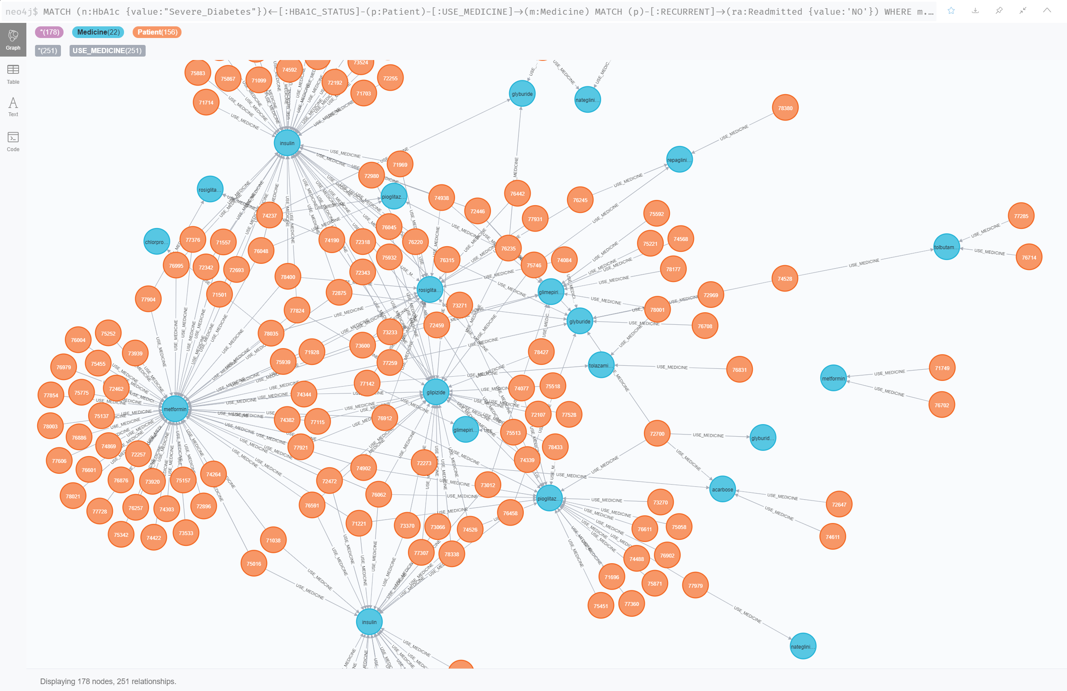
Severe Diabetes (on the encounter) -> No readmission

Slide 26
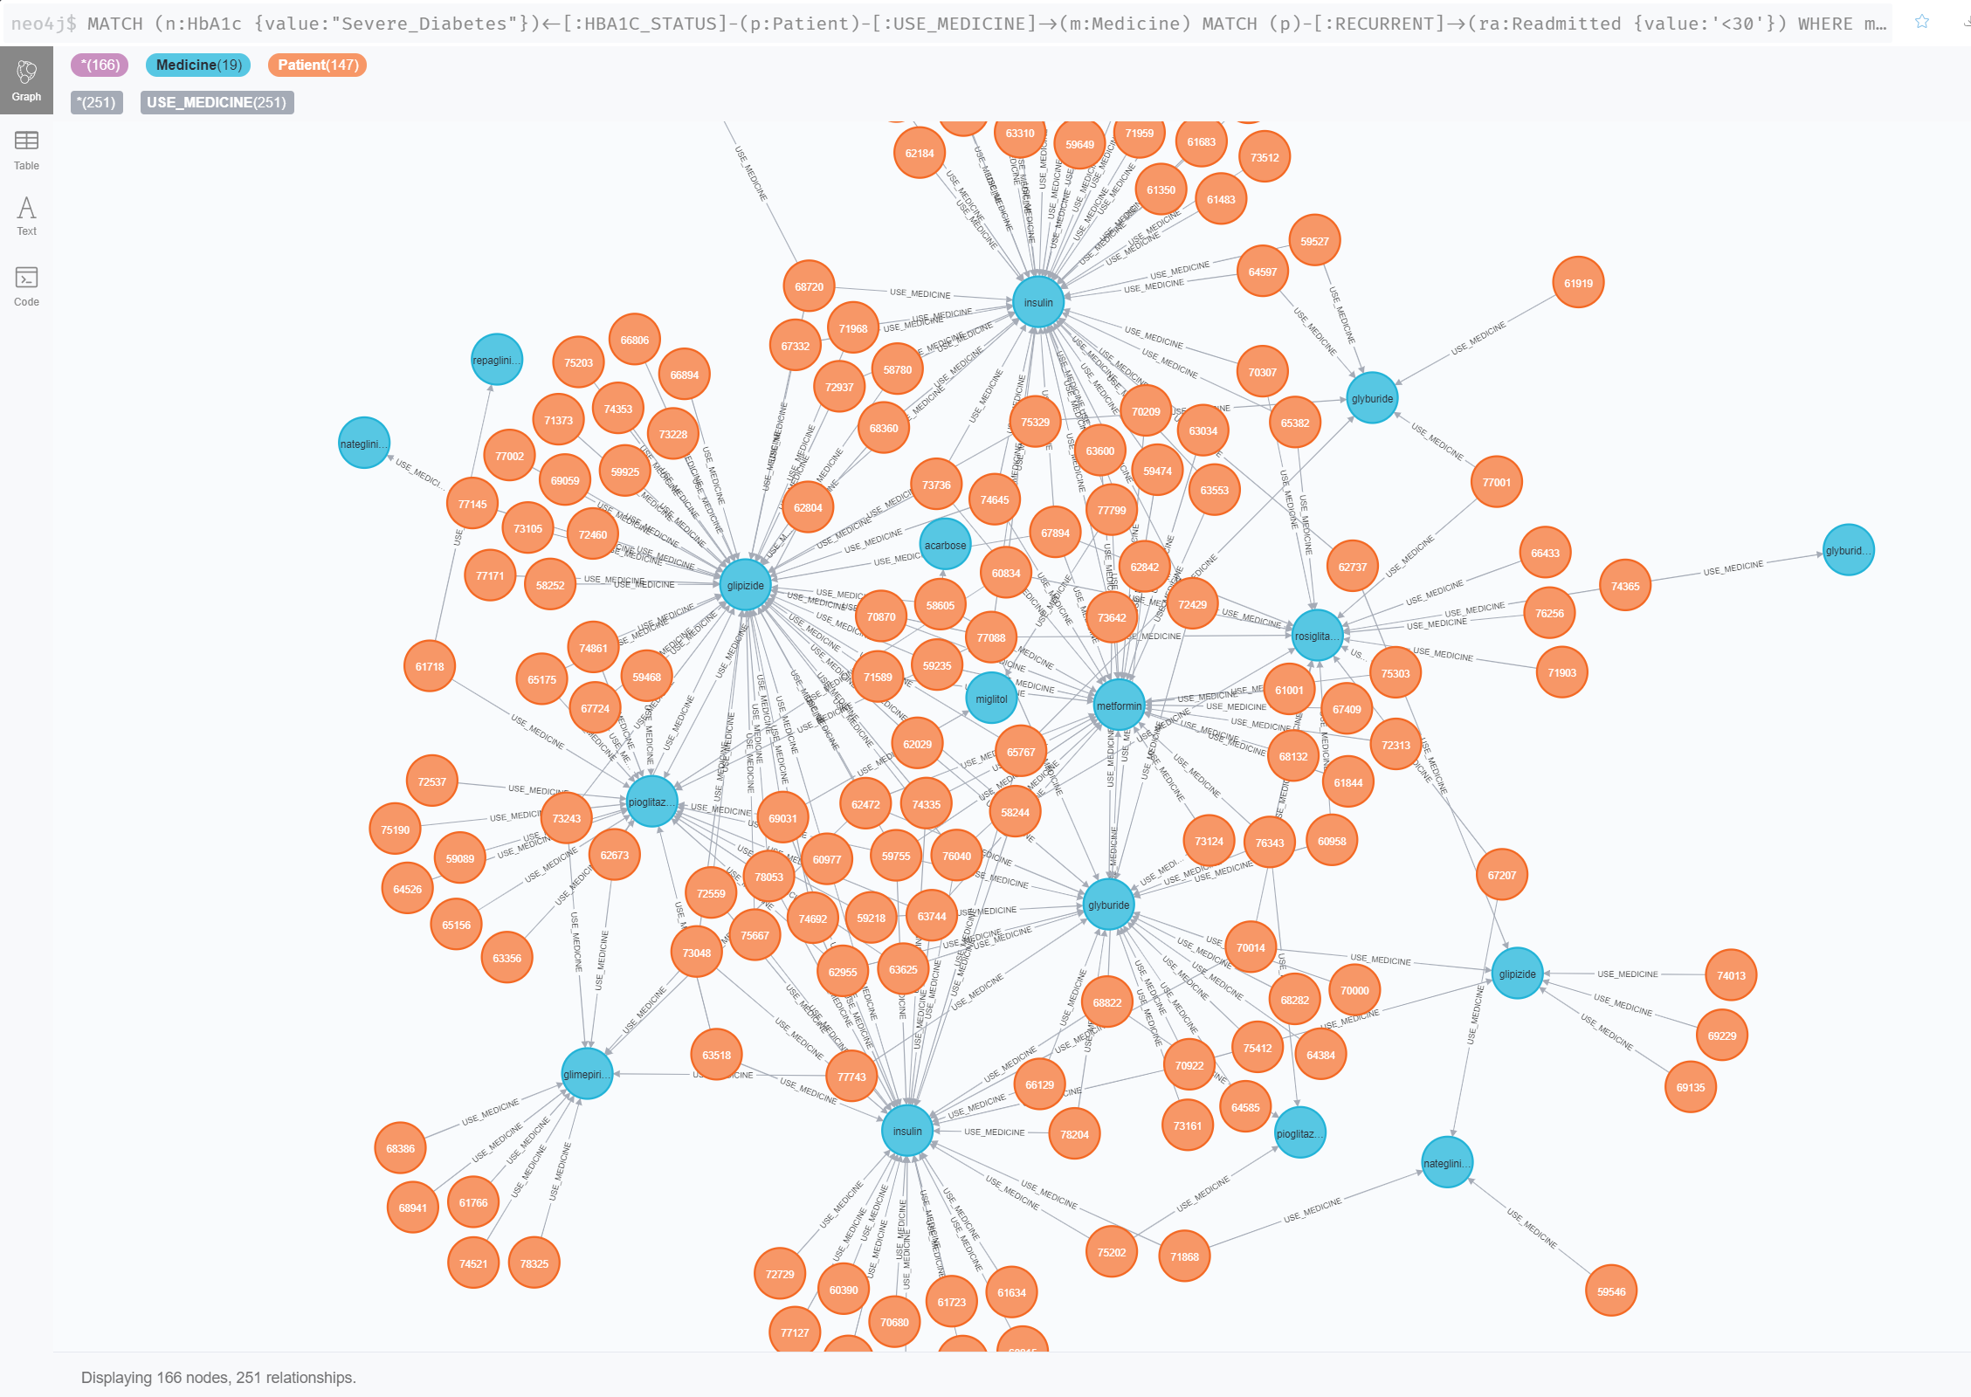
Severe Diabetes (on the encounter) -> Admission in less than 30 days

